Slide 1
OOPS PROJECT TIC TAC TOE
GROUP MEMBERS:
AHMAD SHAHZAD REG ID:23PWCSE2265
MUHAMMAD KAZIM AHMAD REG ID:23PWCSE2233

Slide 2
INTRODUCTIONS
Tic-tac-toe is a classic two-player game played on a 3x3 grid. Players mark a square with either "X" or "O."
The goal is to align three of the same marks in a row, column, or diagonal before the opponent.
The game ends in a draw if all squares are filled without achieving this. It is a simple yet strategic game that fosters critical thinking and planning.

Slide 3
OBJECTIVES
Understand Flutter Basics: Learn the fundamentals of Flutter framework and Dart programming language to build interactive mobile applications.
UI/UX Development: Design an intuitive and visually appealing user interface for a seamless gaming experience.
State Management: Implement efficient state management techniques to track and update the game’s status in real time.
Game Logic Implementation: Develop robust game logic to determine wins, losses, and draws accurately based on player actions.
Interactive Features: Enable user interaction through responsive touch controls and implement functionalities like reset and replay.
Cross-Platform Compatibility: Ensure the game works seamlessly on Android and iOS devices, showcasing Flutter's cross-platform capabilities.

Slide 4
FEATURES USED ARE AS FOLLOW
User-Friendly Interface
Single and Multiplayer Modes
Game State Management
Win and Draw Detection
Reset and Replay Options
Animations and Effects
Light and Dark Mode

Slide 5
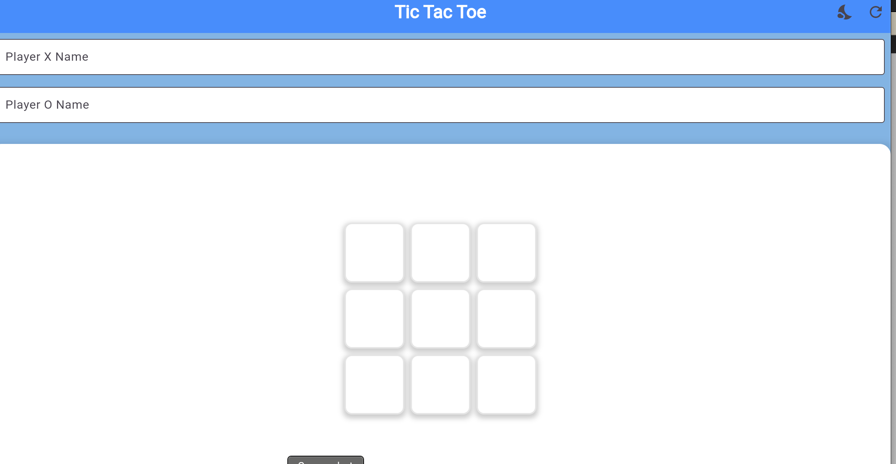
FEATURES USED ARE AS FOLLOW
User-Friendly Interface:
A clean and intuitive design ensures players can easily navigate and interact with the game. The grid is visually appealing, with responsive touch controls for marking squares.

Slide 6
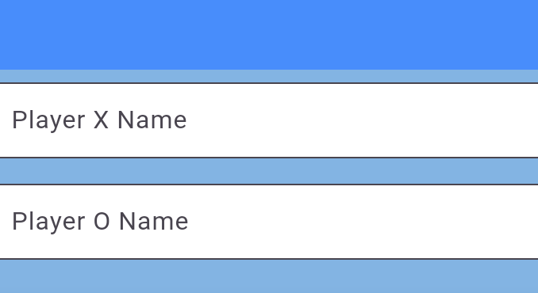
FEATURES USED ARE AS FOLLOW
Single and Multiplayer Modes:
Offers both single-player mode with an AI opponent of varying difficulty levels and multiplayer mode for two players on the same device.

Slide 7
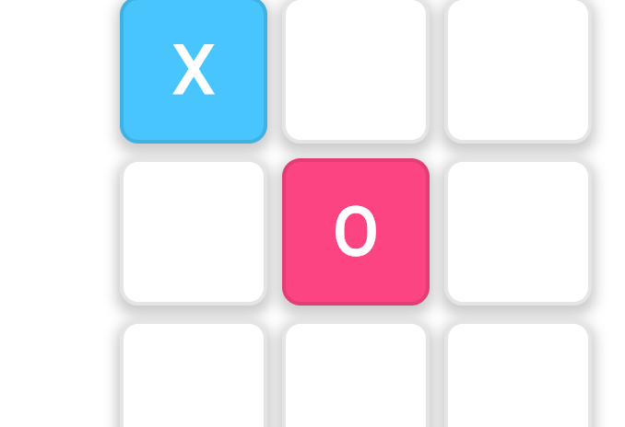
FEATURES USED ARE AS FOLLOW
Game State Management:
Efficiently manages the game's state to track player turns, validate moves, and determine outcomes in real-time.

Slide 8
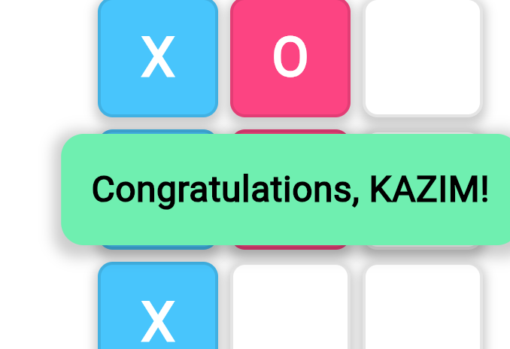
FEATURES USED ARE AS FOLLOW
Win and Draw Detection
Implements logic to detect when a player wins by aligning three marks in a row, column, or diagonal or when the game ends in a draw.

Slide 9

FEATURES USED ARE AS FOLLOW
Reset and Replay Options
Provides a reset button to start a new game instantly, allowing players to replay without restarting the application.

Slide 10
FEATURES USED ARE AS FOLLOW
Animations and Effects Adds animations for player turns, winning combinations, and transitions, enhancing the overall gaming experience.

Slide 11
FEATURES USED ARE AS FOLLOW
Light and Dark Mode Includes support for light and dark themes, adapting to user preferences and improving the visual experience
LIGHT MODE

Slide 12
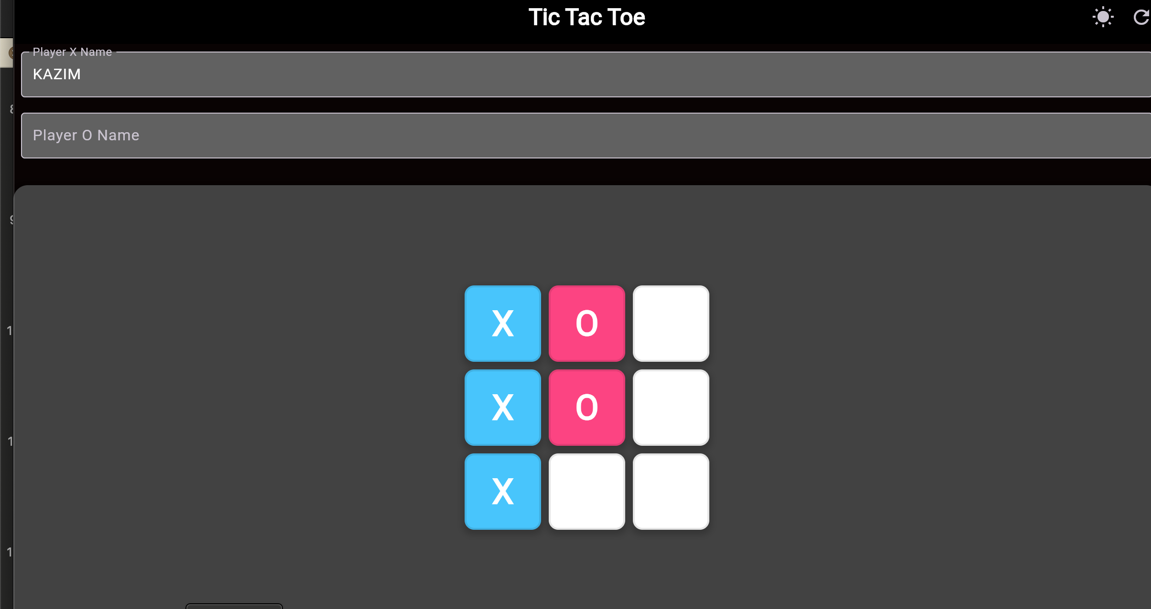
FEATURES USED ARE AS FOLLOW
DARK MODE:

Slide 13
CONCLUSION:
The Tic-Tac-Toe game project developed using Flutter and Dart successfully demonstrates the implementation of a classic game with modern app development techniques. It highlights the importance of user-friendly design, efficient state management, and cross-platform compatibility. This project not only showcases the practical application of programming skills but also enhances understanding of Flutter's capabilities in building interactive and responsive applications. Overall, it serves as a foundational step in creating more complex and feature-rich mobile applications in the future

Slide 14
THANK YOU☺!

